Slide 1
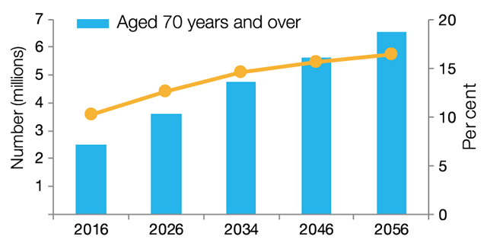

Slide 2
1 Timothy 5:1-16
(English Standard Version)

Slide 3
5 Do not rebuke an older man but encourage him as you would a father, younger men as brothers, ² older women as mothers, younger women as sisters, in all purity.
³ Honour widows who are truly widows. ⁴ But if a widow has children or grandchildren, let them first learn to show godliness to their own household and to make some return to their parents, for this is pleasing in the sight of God. ⁵ She who is truly a widow, left all alone, has set her hope on God and continues in supplications and prayers night and day, ⁶ but she who is self-indulgent is dead even while she lives.

Slide 4
⁷ Command these things as well, so that they may be without reproach. ⁸ But if anyone does not provide for his relatives, and especially for members of his household, he has denied the faith and is worse than an unbeliever.
⁹ Let a widow be enrolled if she is not less than sixty years of age, having been the wife of one husband, ¹⁰ and having a reputation for good works: if she has brought up children, has shown hospitality, has washed the feet of the saints, has cared for the afflicted, and has devoted herself to every good work.

Slide 5
¹¹ But refuse to enrol younger widows, for when their passions draw them away from Christ, they desire to marry ¹² and so incur condemnation for having abandoned their former faith. ¹³ Besides that, they learn to be idlers, going about from house to house, and not only idlers, but also gossips and busybodies, saying what they should not. ¹⁴ So I would have younger widows marry, bear children, manage their households, and give the adversary no occasion for slander. ¹⁵ For some have already strayed after Satan. ¹⁶ If any believing woman has relatives who are widows, let her care for them. Let the church not be burdened, so that it may care for those who are truly widows.

Slide 6
Godliness and Aging
Directions for the Church
Respect
As the Church, we are God’s family. We love; honour; respect
A deep concern for widows, who are particularly vulnerable
Assess
Provide
Godly Living for those who are Aging & Godly Living for All
Self-provision (where possible)
Service (always)
Prayer

Slide 7
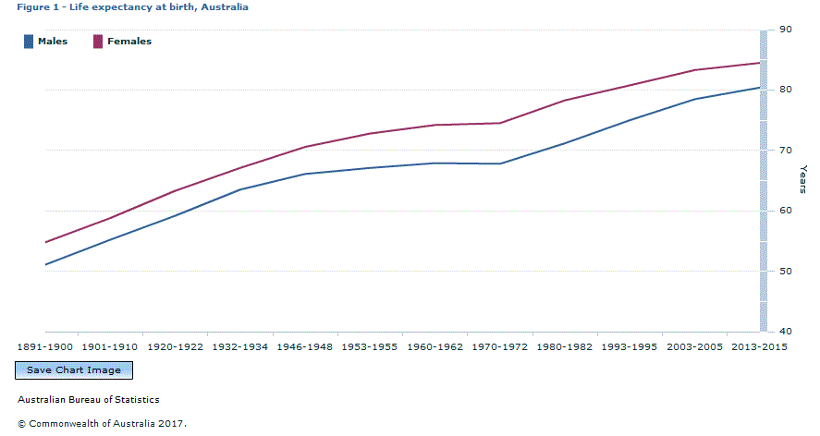

Slide 8
Godliness and Aging
Directions for the Church
Respect
As the Church, we are God’s family. We love; honour; respect
A deep concern for widows, who are particularly vulnerable
Assess
The church provide for the one who is truly alone (one’s family to provide)
The Godly, provide for the Godly. God’s children care for God’s children.
Provide
⁸ But if anyone does not provide for his relatives, and especially for members of his household, he has denied the faith and is worse than an unbeliever.
Godly Living for those who are Aging & Godly Living for All
Self-provision (where possible)
If one is able to provide for themselves, they should do so
If the opportunity is there, re-marry.
⁶ but she who is self-indulgent is dead even while she lives.
Service (always)
The Godliness of serving.
Every Christian, of every age, are called to the Godliness of serving.
The self-indulgent person is spiritually dead Vs. The Godliness of serving others (always).
Prayer
Prayerful service is an expression of profound Godliness

